Slide 1


Faculty Workload and Timetable Management System
DBMSProject Presentation
Presented by: Lingampally Mohith — Roll No: 25WU0102137
Guided By : Dr. Kiran Mayee Adavala

Slide 2
Problem Statement
Departments must allocate courses, compute faculty workload, and produce conflict‑free timetables
Manual/spreadsheet planning causes: faculty, room, section clashes Difficulty calculating workload, handling substitutions and timetable changes
Solution: centralized relational database to store and enforce scheduling rules

Slide 3
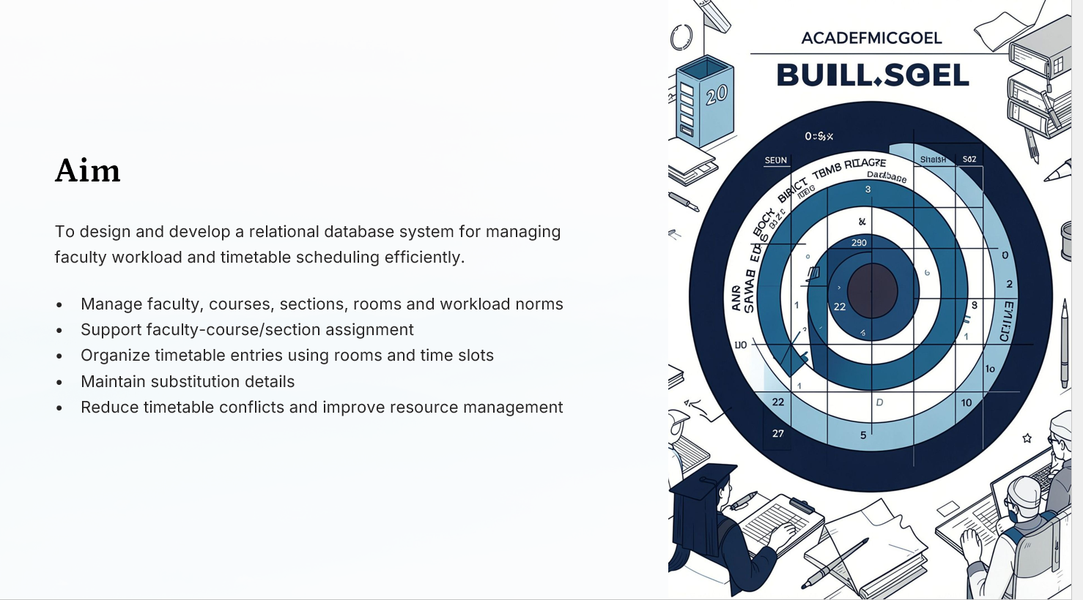

Slide 4











Major Entities
Department
dept_id,
dept_ name
Programme
programme_id, dept_ id
Course
course_id, programme_id, credits
Section
section_id, course_id, strength
Faculty
faculty_id, dept_id
Room / Time Slot
room_id, capacity • slot_id, day, start_time, end_time
Assignment
assignment_id, faculty_id, section_ id
Timetable Entry
entry_id, assignment_id, room_id, slot_id
Substitution
sub_id, original_faculty_id ,
substitute_facul t y _id, entry_id
Workload Norm
norm_id, faculty_type, max_ hours

Slide 5
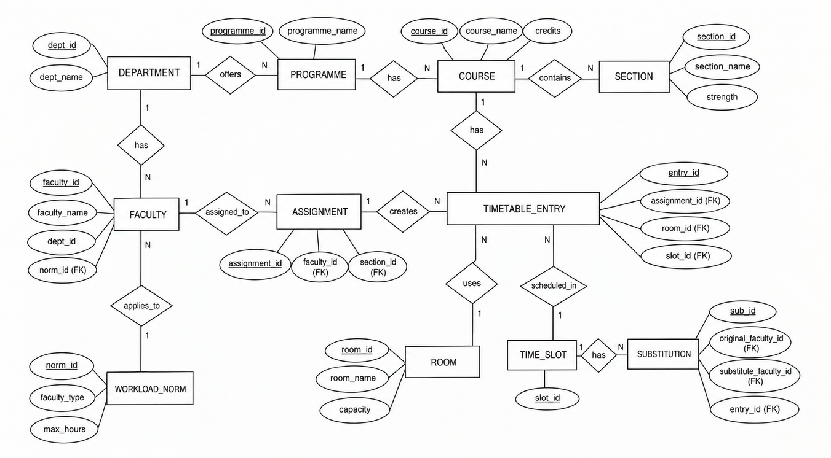
ER Diagram
PKs shown on each entity; FK links labelled (dept_id, programme_id, course_id, faculty_id, assignment_id, room_id, slot_id)

Slide 6
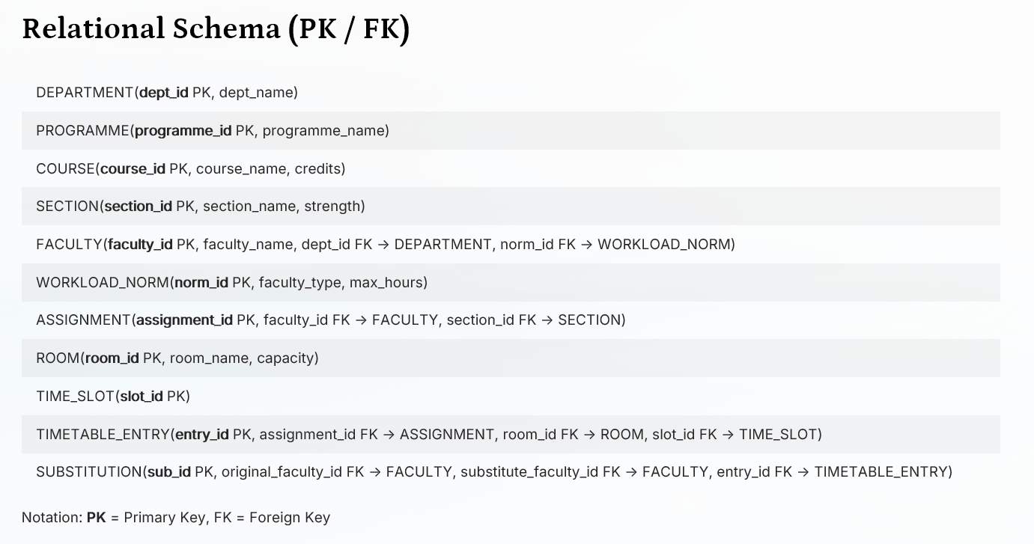

Slide 7
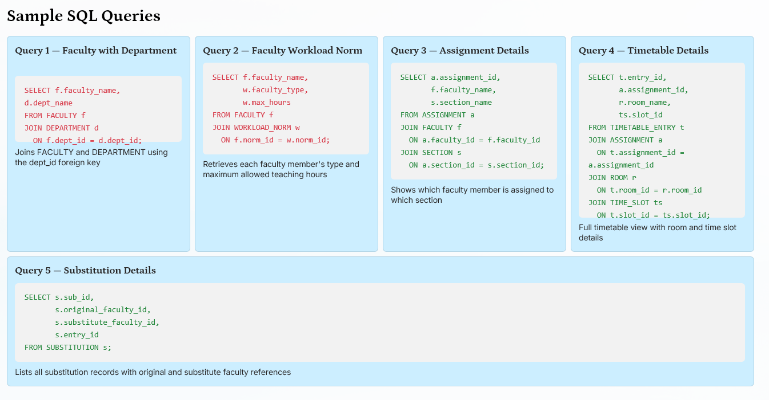

Slide 8
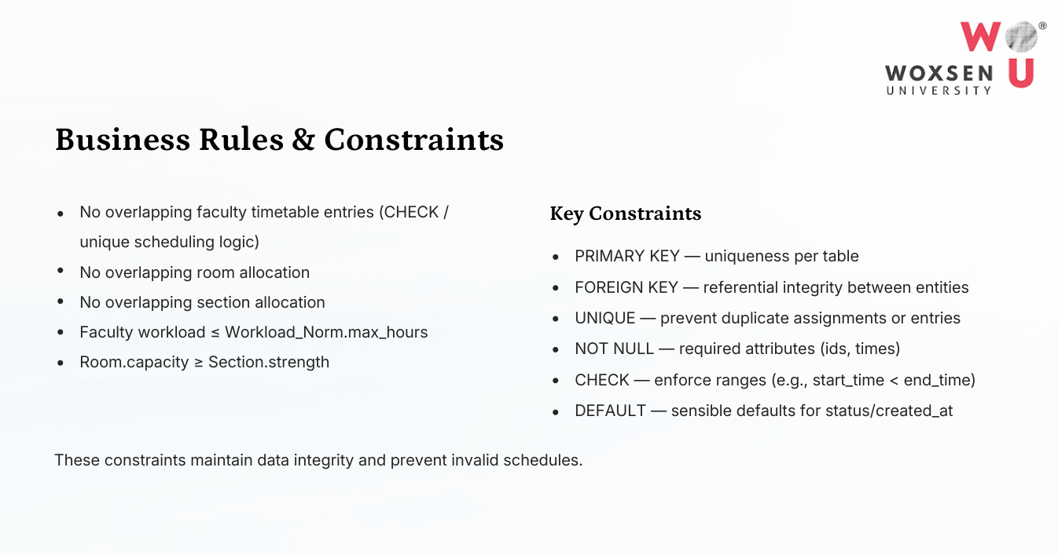

Slide 9







outcomes:
Efficient Faculty Workload Management
Calculate and monitor the teaching workload of each faculty member.
Conflict-Free Timetable Generation
Reduce faculty, room and section clashes during timetable preparation
Centralized Database Management
Store faculty, courses, sections, rooms, time slots and timetable information in one database.
Better Course Allocation
Assign courses/sections to appropriate faculty members while considering workload limits.
Improved Resource Utilization
Efficiently manage classrooms and available time slots based on capacity and availability.
Easy Reporting and Decision Making
Generate reports such as faculty workload, room utilization, timetable, clashes and substitutions.

